Slide 1
Home Rent Prediction System

Slide 2
Team members
Name: Gourab Kanti paul Id: 17182103141 Name: Romzan ali mohon Id: 17182103177 Name: Md. Aminul islam Id: 17182103175

Slide 3
content
Introduction Why this project ? Objective Implementation Schedule DFD (Data flow diagram) Use case diagram E-r diagram Future work Conclusion

Slide 4
introduction
Home Rent Prediction System is an AI-based program that can predict the house price by analyzing the location, size of the room, and the total amount of bedroom. Here, we used a dataset that contains various information about houses including house prices. Our program predicts rent by analyzing the used dataset. This program will help the tenant to find their suitable house which is available for rent by their need. This application reduces the time and works to a greater extent than trying to find houses which is available for rent. Our project Home rent prediction system is developed so that users can view the house rent. Thus, this application provides the specified information in less time and also helps in the quicker higher cognitive process.

Slide 5
Why this project ?
Dhaka is the capital of Bangladesh with a population of 8,906,039. Every day thousands of people come here looking for hope. Our system is made for those hopeful tenants. Here about 60% to 65% of people are tenants. But the number of house owners is low who are willing to give rent their house. It is less than 20%. So, it's very hard to find a house for tenants. Tenants have to go door to door for searching the house or searching a house on different websites. On websites, tenants have only one option for finding the houses. it's the location option. So, it's a very stressful job to find a favorable house at an affordable price. Sometimes they cannot find any and waste their time. We choose this project to improve this problem and make a system that help tenants.

Slide 6
objective
To reduces the users' work as much as possible to search houses which are available for rent. To use a statistical dataset which can give us all information about the house rent. To make the system as simple as possible • To use an algorithm that can give us our rent prediction result

Slide 7
implementation
Implementation is a basic expression of any quit project. To implement our project, we want a development model. We choosing the Linear Regression algorithm. Linear Regression is a machine learning algorithm based on supervised learning. It performs a regression task. Regression models a target prediction value based on independent variables. It is mostly used for finding out the relationship between variables and forecasting. Hypothesis function for Linear Regression: y = θ1 + θ2 * x Here, x: input y: labels θ1: intercept θ2: coefficient of x

Slide 8
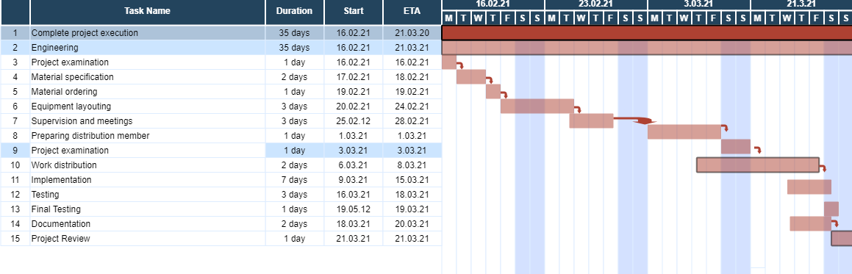
schedule

Slide 9
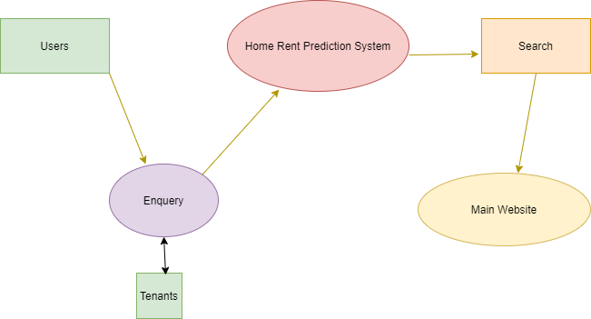
Dfd (Data flow diagram)

Slide 10
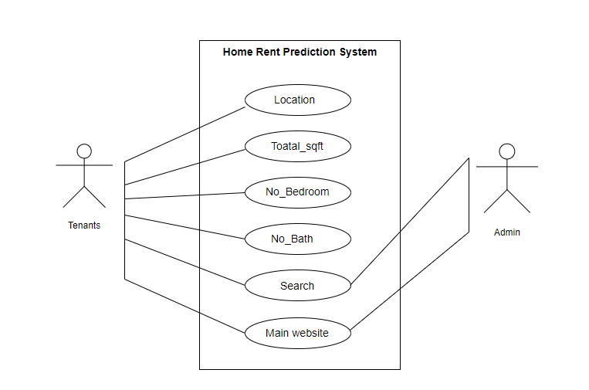
Use case diagram

Slide 11
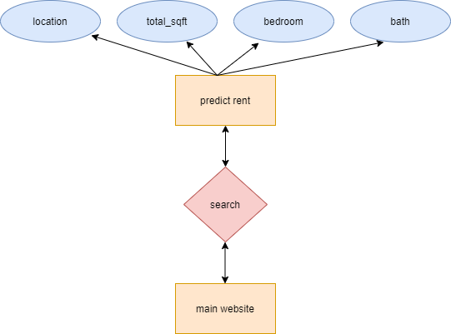
E-r diagram

Slide 12
Future work
The Main future scope of our proposed model about the Home Rent Prediction system is to try it in the real world means we have to implement it with better results. We can improve this system with more accurate results. This system can be used in many websites by special features. It helps the websites to perform better and help the user to enjoy the sites.

Slide 13
conclusion
This system is easy to use for all. Home Rent Prediction System is an AI-based program that can predict the house price by analyzing the location, size of the room, and the total amount of bed-room. Here, we used a dataset that contains various information about houses including house prices. Our program predicts rent by analyzing the used dataset. We used Python programming language which is one of the best high level programming language for Artificial Intelligence. To find a house which is available for rent is a very hard-working job. Our system can make the job a little easy. And tenants can save a lot of time to find their beautiful house.

Slide 14


